Slide 1
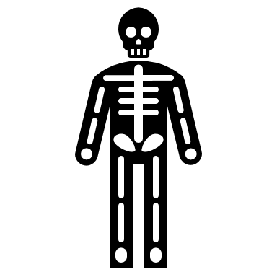
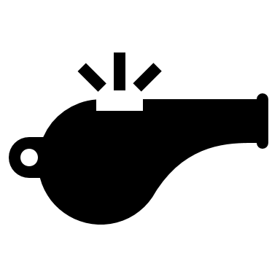
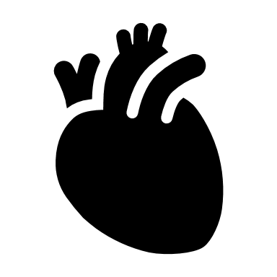
Year 10 GCSE PE Roadmap
Autume 1
The structure and functions of the musculoskeletal system
The structure and functions of the cardio-respiratory system
Autume 2
Anaerobic and aerobic exercise
The short- and long-term effects of exercise
Spring
Movement analysis
Planes and axes of movement
Physical training
The components of fitness, benefits for sport and how fitness is measured and improved
Summer 1
The principles of training and their application to personal exercise/training programmes
How to optimise training and prevent injury
Summer2
Effective use of warm up and cool down
Use of data
Present data (including tables and graphs)
Analyse and evaluate data

