Slide 1
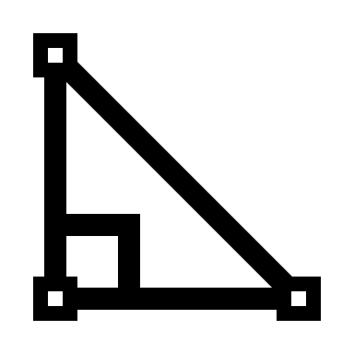
Maths 24-25 Road Map
Year 7
Autumn:
Algebraic Thinking
Place Value and Proportion
Spring:
Application of Number
Directed Number
Fractional Thinking
Summer:
Angles and Lines
Reasoning with Number
Year 8
Autumn:
Proportional Reasoning
Representations
Spring:
Algebraic Techniques
Developing Number
Summer:
Developing Geometry
Reasoning with Data
Year 9
Autumn:
Reasoning with Algebra
Constructing in 2 & 3 Dimensions
Spring:
Reasoning with Number
Reasoning with Geometry
Summer:
Reasoning with Proportion
Representations and revision
Year 10
Autumn:
Similarity
Developing Algebra
Spring:
Geometry
Proportions and Proportional Change
Summer:
Delving into Data
Using Number
Year 11
Autumn:
Graphs
Algebra
Spring:
Reasoning
Revisions and Communication
Summer:
Revision and exams

